Slide 1
APS 1052 Final Project
VOO Weekly & Monthly Returns by ElasticNet Regression Model
Group Member: Yunjie Xu, Zhibin Ma, Wenzong Wang
Date: Dec 20, 2022

Slide 2
Introduction & Project Proposal
Our project makes some enhancements based on the model in Chapter 5 Case Study 1 (Stock Price Prediction) Tatsat’ book. The seed code on which we based our project's code was taken from Hariom Tatsat's Machine Learning and Data Science Blueprints for Finance. We used different stock, ETF, and indices price to forecasting single ETFs futures returns. we used two approach, weekly model & monthly model to predict the target variable. The machine learning model that we performed is elasticnet regression.
https://github.com/tatsath/fin-ml/blob/master/Chapter%205%20-%20Sup.%20Learning%20-%20Regression%20and%20Time%20Series%20models/Case%20Study%201%20-%20Stock%20Price%20Prediction/StockPricePrediction.ipynb

Slide 3
Enhancements
apply the model to new data
include more model parameter grids during cross validation
include new indicator inputs (Using Ta-lib to indicate new indicators)
use a model not discussed in Tatsat (Elasticnet)
prorgam a new indicator
Customize and use customized Scikit-Learn model by combining models
predict a target based on the open price rather than the close price.

Slide 4
Methodology
Step 1 : Input and Frequency
Step 2: Input Handling
Step 3: Fitting Model
Yahoo Finance was used to download all of the data. Our major objective was to forecast the monthly returns of the VOO (S&P500 ETF).
All of the lag variables in our input data were subjected to using Sklearn's Standard Scaler function. And we fill all missing values with mean value.
For the purpose of forecasting the VOO's monthly returns, we opted to employ elasticnet regression. The best parameters were chosen using the Gredient search tool.

Slide 5
Methodology
Step 4: Model Checking
Step 5: Result comparison for two models
We will compare training and testing errors, plot the equity curve, do Metrics & White Reality Check.
Repeating the previous steps for weekly lag, and comparing the target results & performance metrics.

Slide 6
Modules Intro
Module inputs:
1. Numpy (use for mathmatic calculation)
2. Pandas (use for cleaning & transforming dataframe)
3. Matplotlib/Seaborn (Data Visualization)
4. Sci-kit Learn (use for machine learning )
5. Pickle (use for saving the models)
6. Statsmodel (use for statistic model/time series)
7. yFinance (use for extracting Stocks data)
8. Ta-lib (use for implementing indicator)
Model validation inputs:
fAux
WhiteRealityCheck
detrendPrice

Slide 7
Input and Frequency

Slide 8

1.1 Data Inputs
INPUT VARIABLE
Stocks:
Ford (‘F’)
Tesla (‘TSLA’)
General Electric (‘GE’)
BMW （‘BMW’）
ETF:
VUG
SPY
AGG
Indice:
'GSPC'
‘DJI’
‘IXIC’

Slide 9
1.2 Data Description & Target Variable
we have overall 10 input datasets that were downloaded form Yfinance.
4 of them are stocks data from automobile industry, 3 ETFs and 3 Indices are less common use in the industry
The dataset that we used is from 2012-12-15 to 2022-12-15. (twenty years)
The target variable that we want to predict is to predict the monthly return of ETF ‘VOO’.

Slide 10
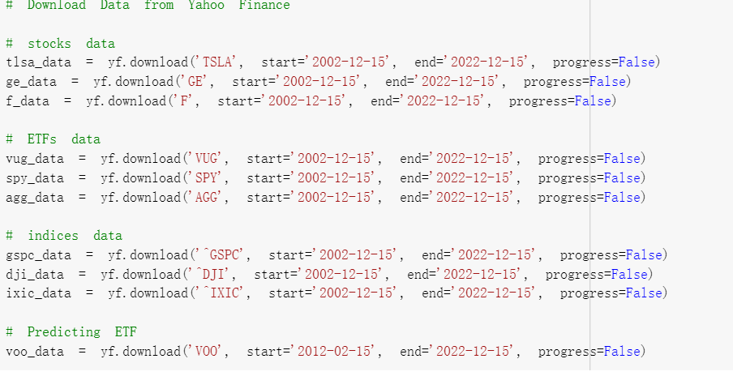
1.3 Data Extraction
As shown on the graph, we used Yfinance to extract the financial data for Stocks, ETFs & Indices.
All the data download as a dataframe starting from 2002-12-15 to 2022-12-15
Therefore, there is no need to import csv file of all the data into the code; all the initial data are store on cloud.

Slide 11
2. Input Handling

Slide 12
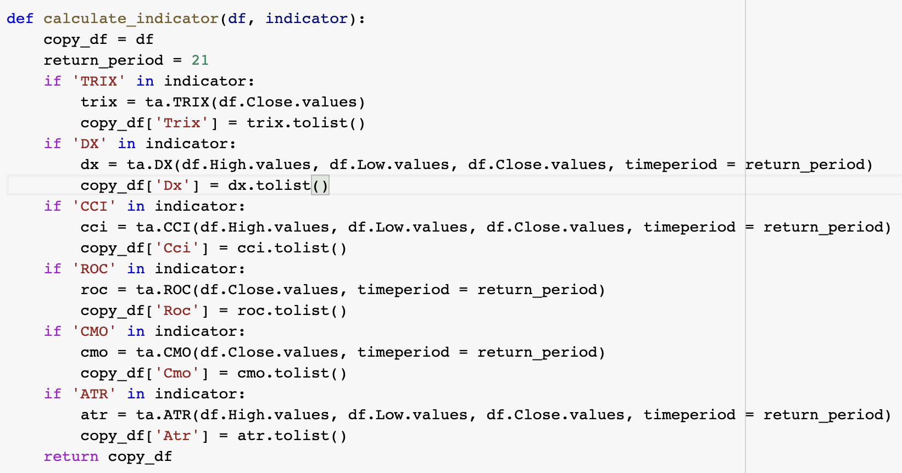
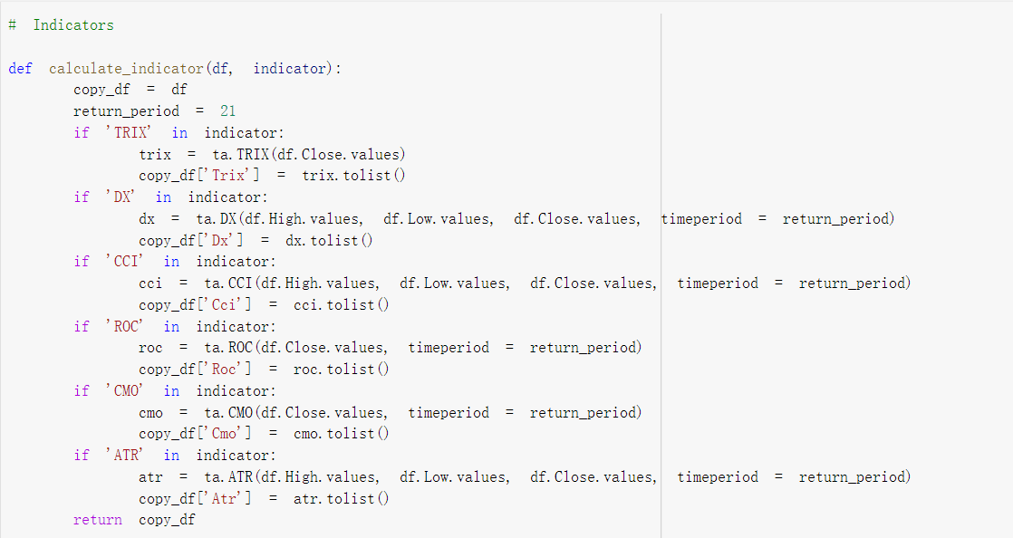
2.1 Indicators
We create a function to calculate the indicators' values based on the Talib package, which is widely used by trading software developers required to perform technical analysis of financial market data.

Slide 13
2.1 Indicators: Triple Exponential Average(TRIX)
ATR stands for Average True Range, which is the average of true ranges throughout the given time frame. ATR calculates volatility by accounting for any gaps in price movement. 14 periods, which may be intraday, daily, weekly, or monthly, are often used in the ATR calculation¹.

Slide 14
2.1 Indicators: Directional Movement(DM)
J. Welles Wilder created the directional movement index (DMI) in 1978 as an indicator to show which way an asset's price is heading. The indicator achieves this by generating two lines: a positive directional movement line (+DI) and a negative directional movement line (-DI) based on a comparison of previous highs and lows (-DI). The average directional indicator (ADX), a third line that is optional, may also be used to determine the strength of an uptrend or downturn².

Slide 15
2.1 Indicators: Chande Momentum Oscillator(CMO)
The difference between the sum of all recent higher closes and the sum of all recent lower closes is calculated for the CMO indicator, which is then formed by dividing the result by the total amount of price movement over a specified time period³. The range of -100 to +100 is obtained by multiplying the result by 100.

Slide 16
2.1 Indicators: Price Rate of Change(ROC)
A momentum-based technical indicator named the Price Rate of Change (ROC) calculates the percentage change in price between the current price and the price from a specific number of periods ago⁴.

Slide 17
2.1 Indicators: Commodity Channel Index(CCI)
When an investment vehicle is approaching an overbought or oversold state, the Commodity Channel Index (CCI), a momentum-based indicator, may aid⁵. This technical indicator evaluates the direction and intensity of the price trend, enabling traders to choose whether to initiate or quit a trade, forgo entering a trade, or increase an existing position.

Slide 18
2.1 Indicators: Average True Range(ATR)
ATR stands for Average True Range, which is the average of true ranges throughout the given time frame. ATR calculates volatility by accounting for any gaps in price movement⁶. 14 periods, which may be intraday, daily, weekly, or monthly, are often used in the ATR calculation.

Slide 19
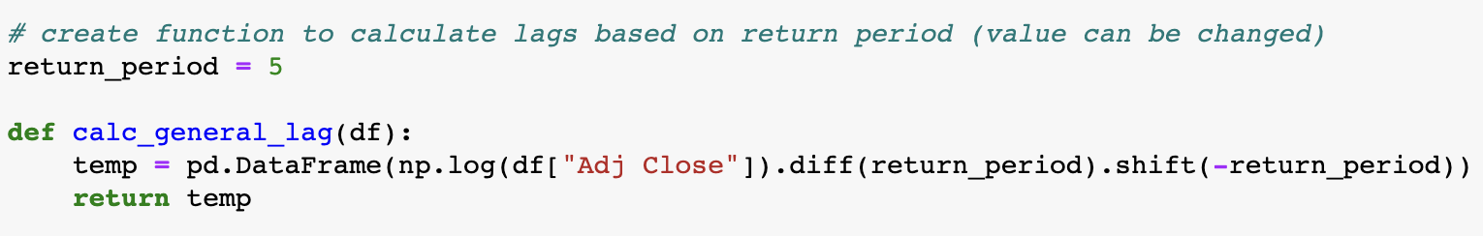
2.2 Lags Calculation
Lagging a time series refers to moving the values of that time series ahead or backward by one or more time steps, respectively⁷. We build a function to compute lags based on the return period and set each return period to be 5 days.

Slide 20
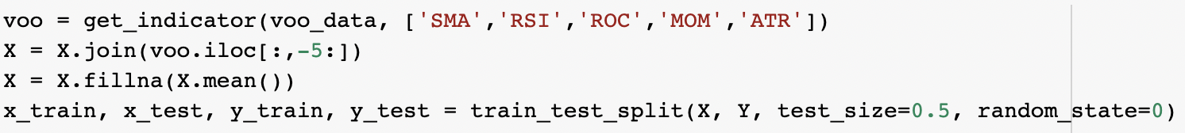
2.3 Missing Values and Input Processing
We normalise the dataset using the standard scaler and replace missing values with mean values. The figures are adjusted through standardisation to make it simple to compare values that fall beyond the purview of one another.

Slide 21
3. Fitting Models

Slide 22
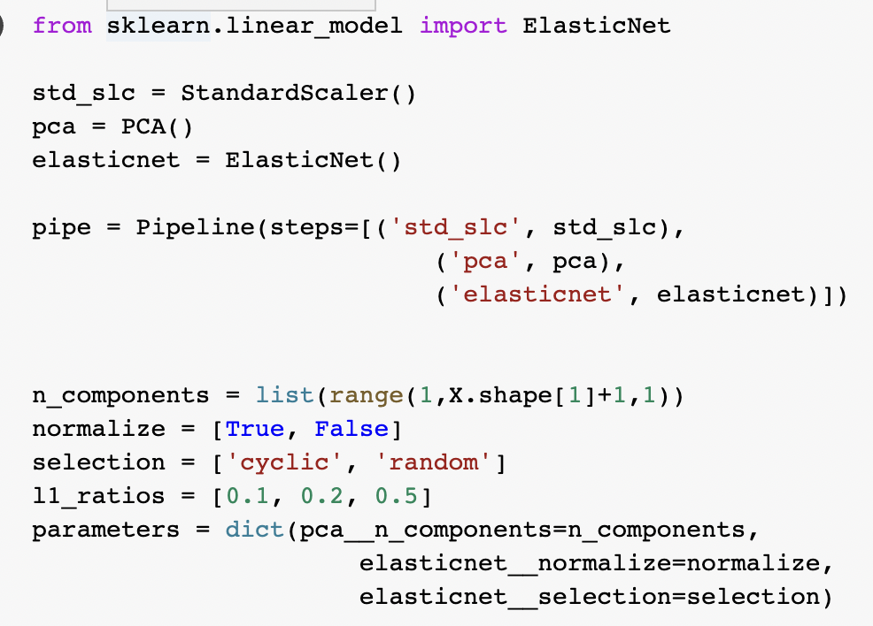
3.1 GridSearch and Best Hyperparameter Values
GridSearch：In order to select the optimal model, we iteratively improve our classifier using GridSearchCV. Using GridSearchCV from SKlearn is among the finest ways to accomplish this. From the set of parameters you enter, it can offer you the best options⁸ This class is contained in the sklearn.model selection package.
We create a dictionary to store all possible hyperparameter values. Then we apply the gridsearch with pipline to find the best hyperparameter values.

Slide 23
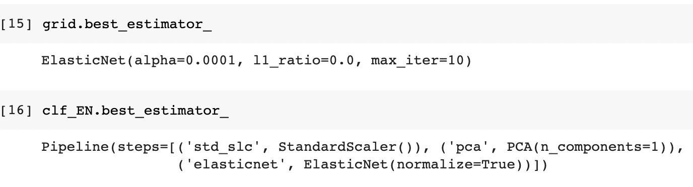
3.1 GridSearch and Best Hyperparameter Values

Slide 24
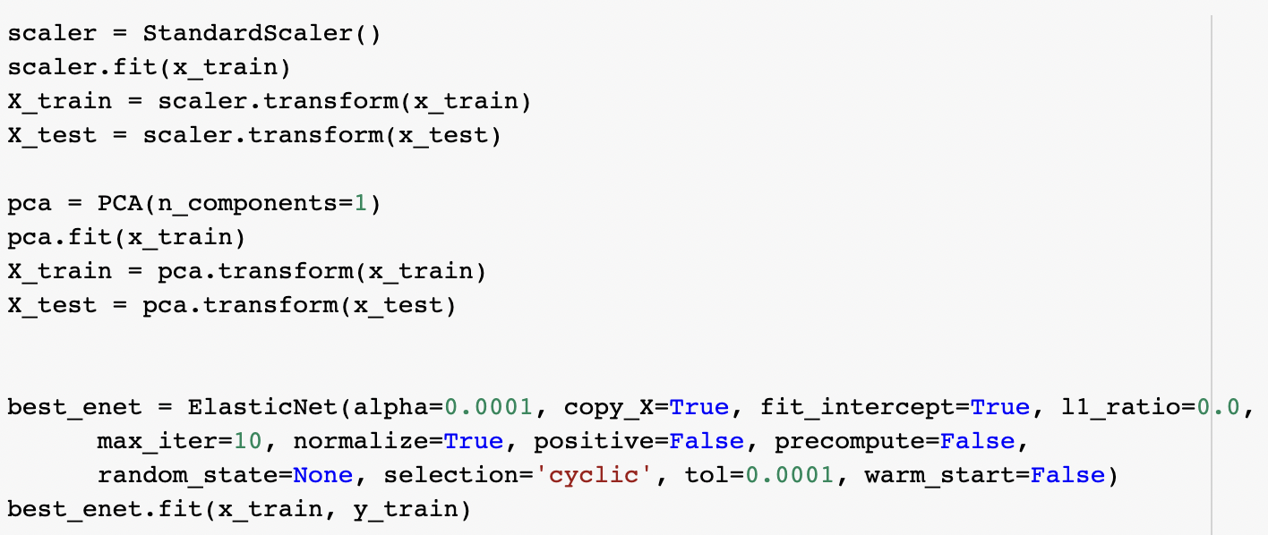
3.2 Fitting the Model: ElasticNet Regression
Elastic net linear regression regularises regression models by using the penalties from the lasso and ridge procedures. In order to improve the regularisation of statistical models, the strategy combines the lasso and ridge regression approaches⁹.
Here, we use ridge regression (L1_ratio equal with 0) to fit the dataset.

Slide 25
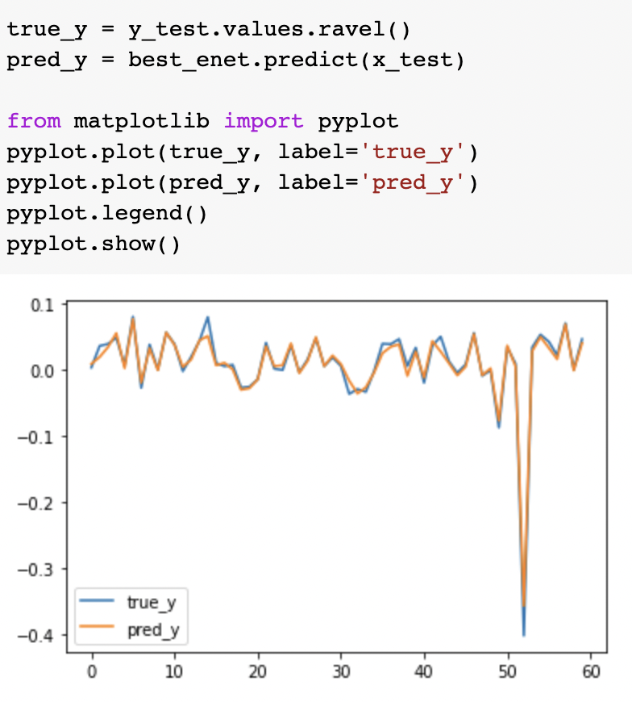
3.3 Model Results (Monthly)
We plot the true_y values and predict_y values.
The plot indicates that our model works very well.

Slide 26
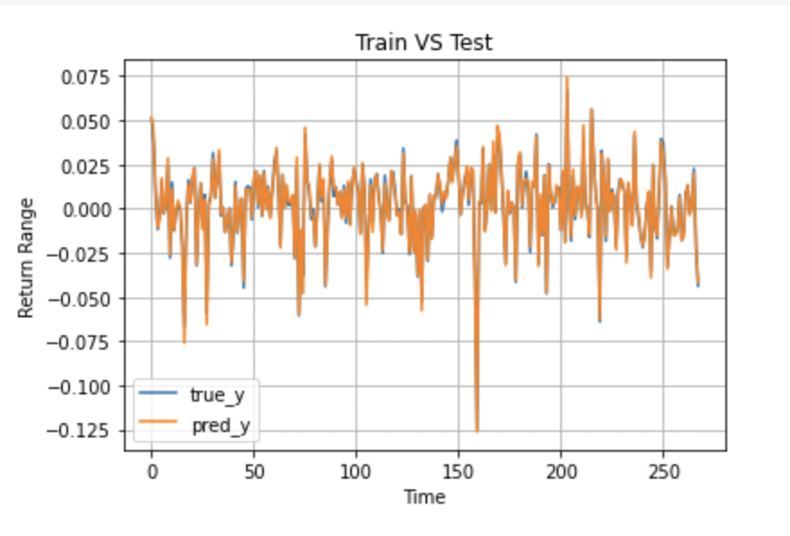
3.3 Model Results (Weekly)
We plot the true_y values and predict_y values.
The plot indicates that our model works very well.

Slide 27
4. Model Checking

Slide 28
4.1 White Reality Check(WRC)
Step 1：Develop a Strategy
Keep track of all strategy iterations that were tried out and dropped due to test results, including all discarded algorithms, concepts, techniques, and parameters. It makes no difference if they were eliminated by a human choice, a machine search, or an optimization procedure. Create balance curves for each variation of the approach while using detrended trade data and no trade fees. Make a note of the best strategy's profit P.

Slide 29
4.1 White Reality Check
Step 2: Bootstrapping
Subtracting the mean return per bar from all balance curves detrends them (this is distinct from detrending trade results!). In this manner, you obtain a set of curves that share the traits of the tested systems but yield no profit. Bootstrap all curves with replacement and randomise them. As a result, new curves are created from the existing curves' random returns. Since the same bars can be chosen several times, the majority of new curves now create profits or losses that are not zero¹⁰. Choose the randomised curve that performs the best, then record its profit. Repeat the previous two steps a few thousand times. You currently possess a list of over a thousand finest earnings. The Data Mining Bias according to your strategy development method is the median M of that list.

Slide 30
4.1 White Reality Check
Step 3: Review P-value
Look at the position of the list's initial best profit P. The so-called p-Value of the best strategy is the proportion of best bootstrap profits greater than P. The p-Value should be as small as possible. The optimal approach has a real edge with a 95% probability if P is more than 95% of the best bootstrap profits. The outcome to be anticipated when using the optimal approach in actual trading is P minus M minus trade costs.

Slide 31
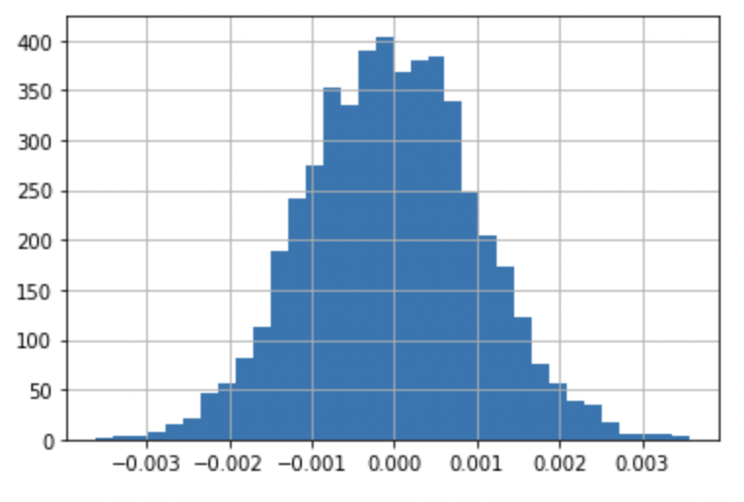
4.1 White Reality Check (Monthly)
P-Val = 0.919, thus the null hypothesis cannot be rejected. The population of rule return is expected to be zero or less than zero.

Slide 32
4.2 Metrics Check
CAGR
Sharpe Ratio
Calmar Ratio
Spearman’s rank correlation
maxDDD/maxDD

Slide 33
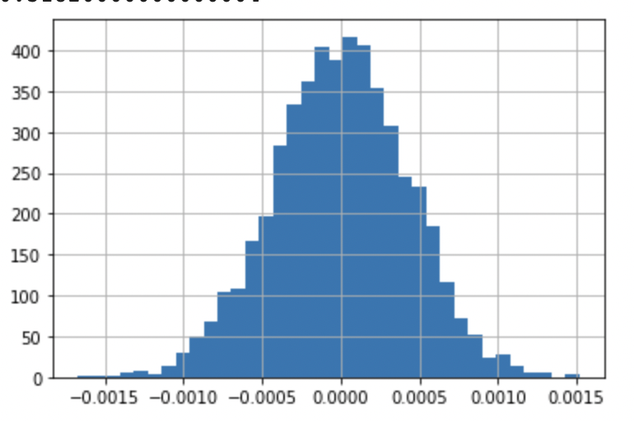
4.1 White Reality Check (Weekly)
P-Val = 0.318, thus the null hypothesis cannot be rejected. The population of rule return is expected to be zero or less than zero.

Slide 34
4.2 Metrics Check: CAGR (Compound annual growth rate)
The rate of return (RoR) needed for an investment to increase from its starting balance to its ending balance, providing profits were reinvested at the conclusion of each period of the investment's life span, is known as the compound annual growth rate (CAGR)¹¹.

Slide 35
4.2 Metrics Check: Sharpe Ratio
The Sharpe Ratio is used to calculate the anticipated return per unit of risk for a zero investment plan¹².

Slide 36
4.2 Metrics Check: Spearman rank correlation
The Spearman Rank correlation explain how well the relationship between two ranked time series¹³.

Slide 37
4.2 Metrics Check: (Monthly)
 | Training Set (monthly) | Testing Set (monthly)
CAGR | 0.00606 | 0.0104929
Sharpe Ratio | 0.2413 | -0.38926
Calmar Ratio | 0.113 | -0.122
Rho/PVal | 0.9589/1.97 e-33 | 0.95/1.97 e-33
(maxDD/maxDDD） | -0.0535/25 | -0.085/40

Slide 38
4.2 Metrics Check: (Weekly)
 | Training Set (Weekly) | Testing Set (Weekly)
CAGR | 0.0346 | 0.0298
Sharpe Ratio | 0.62 | 0.08073
Calmar Ratio | 0.54 | 0.018
Rho/PVal | 0.99/0 | 0.99/0
(maxDD/maxDDD） | -0.06/69 | -0.1612/182

Slide 39
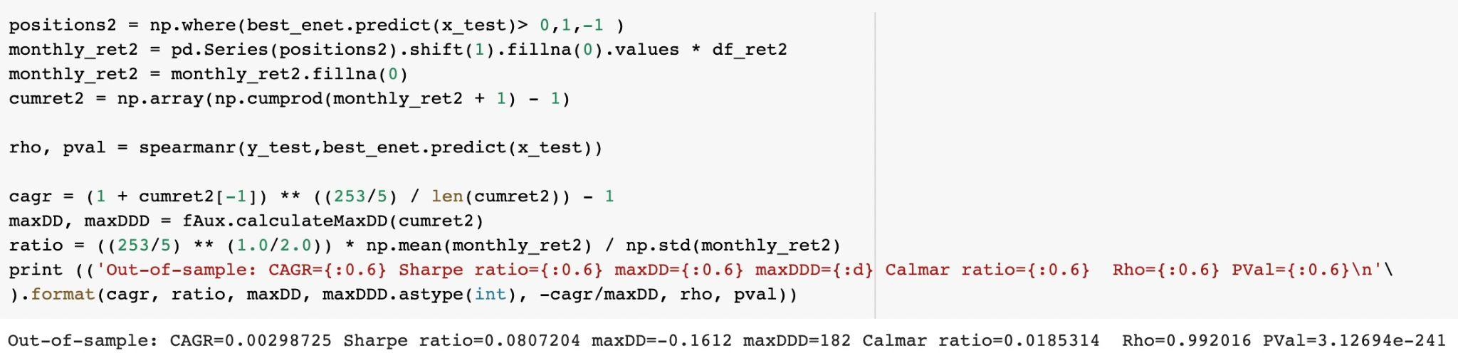
4.2 Metrics Check Code

Slide 40
4.3 Equity Curve
An equity curve is a graphical representation of the change in the value of a trading account over a time period¹⁴. An equity curve with a consistently positive slope typically indicates that the trading strategies of the account are profitable, while a negative slope shows that they are generating a negative return.

Slide 41
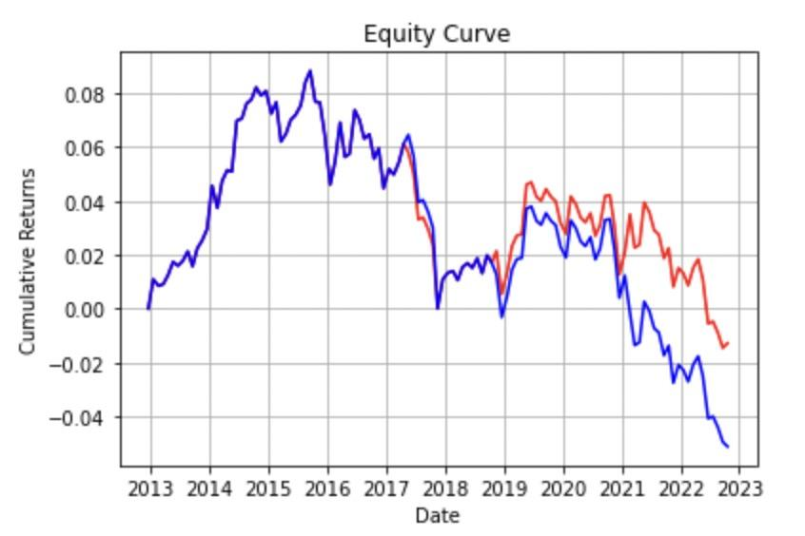
4.3 Equity Curve (Monthly)

Slide 42
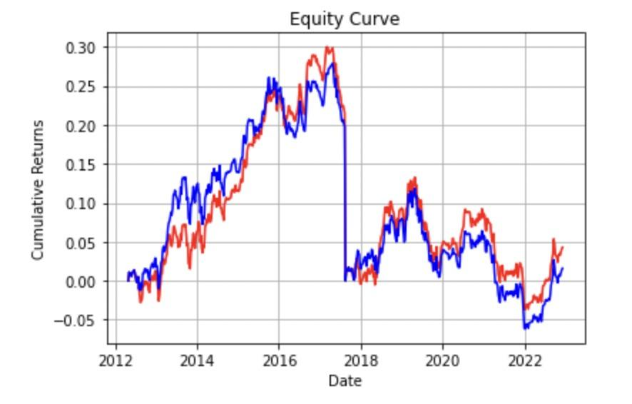
4.3 Equity Curve (Weekly)

Slide 43
Analysis & Conclusion

Slide 44
Market Return Predictions
Both weekly & monthly model use elasticnet with l2 penalty equals to 1. (Ridge Regression)
According to the graphs, monthly model has less data points comparing to the weekly model; therefore, weekly model has large fracutation on the return.
Both predictive return of weekly and monthly model accurately catches the real market trends and characteristics.

Slide 45
White Reality Check Predictions
Monthly model has p-val equal to 0.9
Weekly model has p-val equal to 0.38
Both models have normal distribution around zero
Comparing with monthly model and weekly model P val, weekly model has better performance than monthly model.

Slide 46
Performance Metrics Analysis
For the testing metrics of monthly model, both Calmar ratio & Sharpe ratio has negative values which means the predictive model has bad performance on monthly return
Both model has postive CAGR means that the return of the stock will increase every year. (weekly model has higher CAGR than monthly model for training set)

Slide 47
Equity Curve Analysis
For monthly equity curves, the predictive value accurately match with the true values, however after 2019, the predictive equity curve separates from the true equity curve.
For weekly equity curves, the predictive value matches the true value closely at the all time
Therefore, estimating equity curve using weekly model outperform monthly model.

Slide 48
CONCLUSION
By comparing all the metrics and performance of weekly model and monthly model, we conclude that when predicting the stock return, using weekly model has better performance than monthly model.

Slide 49
References
[1]: Sang, Cung Lian, et al. "A comparative study of UWB-based true-range positioning algorithms using experimental data." 2019 16th Workshop on Positioning, Navigation and Communications (WPNC). IEEE, 2019.
[2]:Shaikh, Saif Malik, and Mandar Karyakarte. "Study of Indian Stock Market and various factors affecting it and various Indicators."
[3]:Patterson M G. What is energy efficiency?: Concepts, indicators and methodological issues[J]. Energy policy, 1996, 24(5): 377-390.
[4]: Ye, Furong, et al. "A novel forecasting method based on multi-order fuzzy time series and technical analysis." Information Sciences 367 (2016): 41-57.
[5]:Menkveld, Albert J. "The Economics of High-Frequency Trading." Annual Review of Financial Economics 8 (2016): 1-24.
[6]: Białkowski, Jędrzej, Katrin Gottschalk, and Tomasz Piotr Wisniewski. "Stock market volatility around national elections." Journal of Banking & Finance 32.9 (2008): 1941-1953.

Slide 50
References
[7]:Siami-Namini, Sima, Neda Tavakoli, and Akbar Siami Namin. "A comparison of ARIMA and LSTM in forecasting time series." 2018 17th IEEE international conference on machine learning and applications (ICMLA). IEEE, 2018.
[8]: Amr, Tarek. Hands-On Machine Learning with scikit-learn and Scientific Python Toolkits: A practical guide to implementing supervised and unsupervised machine learning algorithms in Python. Packt Publishing Ltd, 2020.
[9]:Usman, M., S. I. S. Doguwa, and B. B. Alhaji. "Comparing the Prediction Accuracy of Ridge, Lasso and Elastic Net Regression Models with Linear Regression Using Breast Cancer Data." Bayero Journal of Pure and Applied Sciences 14.2 (2021): 134-149.
[10]:Perlich, Claudia, Foster Provost, and Jeffrey Simonoff. "Tree induction vs. logistic regression: A learning-curve analysis." (2003).
[11]:Gompers, Paul, and Josh Lerner. "The venture capital revolution." Journal of economic perspectives 15.2 (2001): 145-168.
[12]:Sharpe, William F. "The sharpe ratio." Streetwise–the Best of the Journal of Portfolio Management (1998): 169-185.

Slide 51
References
[13]: Armstrong, J. Scott, and Fred Collopy. "Error measures for generalizing about forecasting methods: Empirical comparisons." International journal of forecasting 8.1 (1992): 69-80.
[14]:Georgakopoulos, Harry. "Spreads, Betas and Risk." Quantitative Trading with R. Palgrave Macmillan, New York, 2015. 119-145.

Slide 52
Thanks

